Slide 1
Your
HEALTH
is
your
wealth
HARNESS
the power
Nutrition
OF
|

Slide 2
STATE OF THE NATION
Quality of life has decreased
Obesity is at an all-time high
We are using more prescription drugs than ever
Record deaths from heart disease and cancer
Life expectancy has increased
Notes:
Does living longer really matter if we are sicker, fatter and more dependent on drugs and others to care for us?
We want to explore how our lifestyle has changed over the past 50-60 years and what type of impact it has had on our health as a nation.
The great news is that much of the decline in our health is due to poor choices we make – so that gives us a great opportunity to improve our choices and our health. There is a lot of hope here in changing the health of our country.

Slide 3
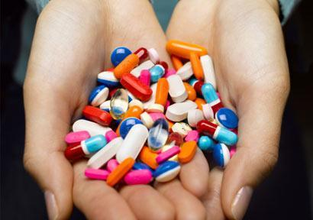
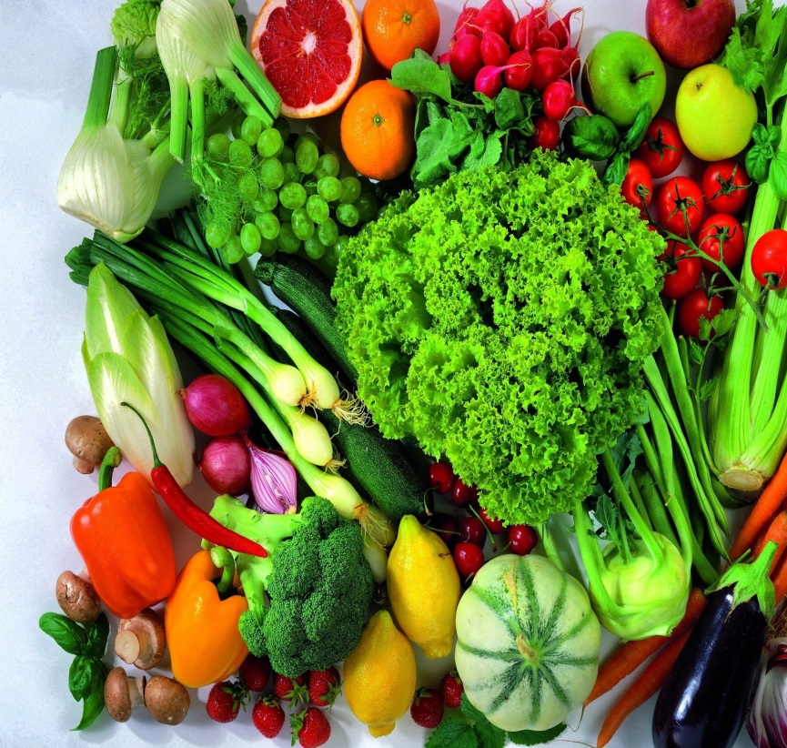
MORE
COMPUTER
WORK
PROCESSED FOODS
OXIDATIVE STRESS
TV
STRESS
PESTICIDES
PRESCRIPTION DRUGS
CONTRIBUTING FACTORS
LESS
SLEEP
EXERCISE
QUALITY FOODS
Notes:
There are only 24 hours in each day and we are a 24/7 society. We increasingly trying to shove more into our days – more work, more driving, more computer – technology has made us accessible 24/7 leaving us less time for exercise, less time for family, less time for cooking healthy meals, less time for sleep. The 8 hour work day doesn’t exist for many people these days.

Slide 4
ENVIRONMENTAL CHANGES
The pollutants found today vs. in the century past (air, food, and water) drastically increase the number of free radicals we produce internally and those we have to fight externally.
Our toxic burden varies day to day, as does our ability to defend ourselves.
The present generation faces the largest burden from oxidative stress this planet has ever known.
Notes:
Increase in air pollution increases exposure to environmental toxins.
Increased toxins in our food, water, etc.
The more drugs (RX) we take, those pass through into our sewage system and often aren’t filtered out from our drinking water.
Increase in air pollution increases exposure to environmental toxins.
Increased toxins in our food, water, etc.
The more drugs (RX) we take, those pass through into our sewage system and often aren’t filtered out from our drinking water.
A free radical is a atom or group of atoms that has one unpaired electron. (natural biological process) or from outside sources that would damage the cells. Also, known as oxidative stress.

Slide 5
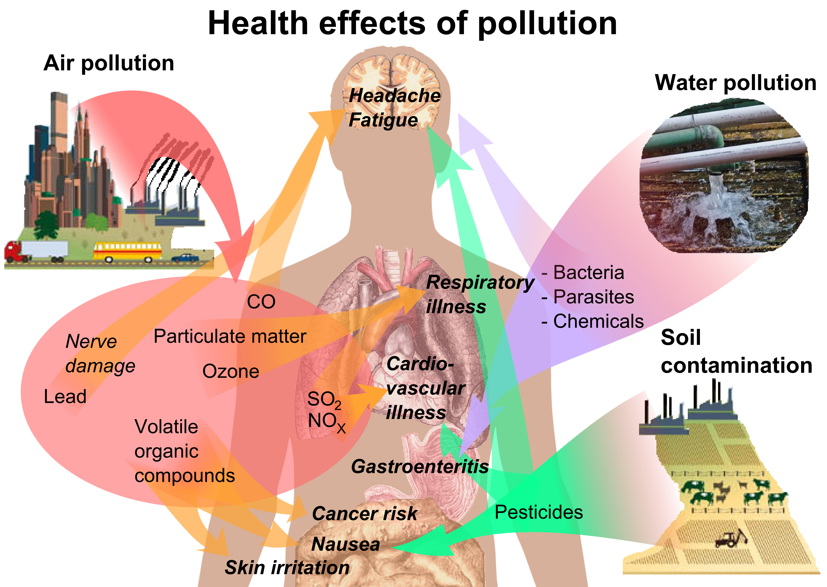

Slide 6
Quality of food has decreased
Our foods have become significantly depleted in their content of antioxidants and supporting minerals.
Factors;
Mineral depletion in our soils
Monoculture crops and agriculture
Food transportation issues
Food preparation
Notes:
Monoculture is growing one single crop over a very large area – industrialised practice – leads to quicker spread of disease among crops

Slide 7
Global Effects
Global food production depends on land, water and energy (particularly fossil fuels) to produce, process and distribute food.
Fertile lands for food production are diminishing due to urbanisation, and land being increasingly diverted to mining and biofuel production.
Soils that are eroding, increasing in salt content and being depleted of nutrients threaten sustainable food production.
The world’s supply of clean, fresh water is steadily decreasing, with demand exceeding supply in many parts of the world.
Notes:
http://www.aihw.gov.au/WorkArea/DownloadAsset.aspx?id=10737422357

Slide 8
State of Australia’s Soil
Australian soils differ from those of northern America or Europe, where much scientific study on soil regeneration is taking place. Australian soils are generally older and have been exposed to constant weathering.
Approximately 50 per cent of Australian agricultural land has surface pH values less than or equal to 5.5, which is below the optimal level to prevent soil acidification
In Australia, our ancient soils were inherently depleted prior to the introduction of European agricultural practices
Notes:
http://www.futuredirections.org.au/publication/the-state-of-australia-s-soils/

Slide 9
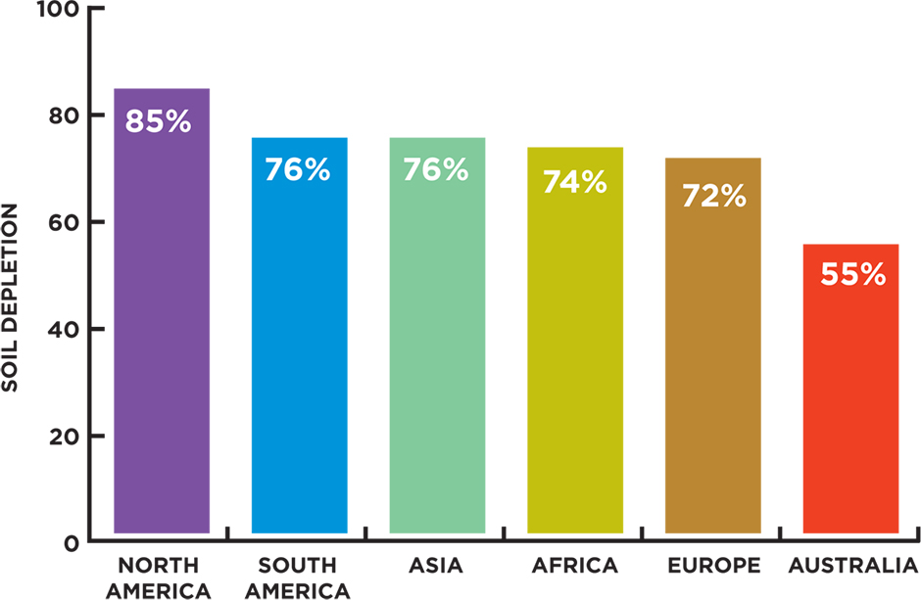
In 1992, The Earth Summit Report concluded that over the previous 60 years the mineral content in our soils had depleted by up to 85%. The senate report went on to say: "No man of today can eat enough fruits and vegetables to supply his system with the vitamins and minerals he requires for perfect health".

Slide 10
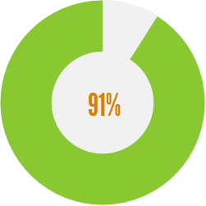
National Nutrition Survey
ONLY 50% OF AUSTRALIANS ARE EATING ENOUGH FRUIT
91% OF AUSTRALIANS ARE NOT EATING ENOUGH VEGGIES
1
ONLY ONE IN TWENTY (5.1%) ADULTS MET BOTH GUIDELINES
20

Slide 11
We rely heavily upon the quality of the food and dairy produce we eat for our nutrients;
Plants construct beneficial nutrients substances from soil
These nutrient structures are then created in a form for the human body
The body identifies and utalises nutrients to function

Slide 12
As a result, due to the decrease in plant nutrition value a common trend has been to supplement the foods with "natural" vitamins and minerals to try and replenish the intake of lost nutrients.

Slide 13
COMPLEMENTORY MEDICINE INDUSTRY
More than two-thirds of Australians use Complementary Medicines
Australian’s spending up to $2 billion in out of pocket expenses on complementary medicines
1.3 million Australians with chronic conditions regularly applied Complementary Medicines for treatment
Industry revenue $3.5 billion expended growth to $4.6 billion in 2017-2018
Notes:
Ref: Complementary Medicines Australia

Slide 14
RESTORATIVE VALUE OF NUTRIENTS
Notes:
The previous slides gave some pretty sobering statistics but there is good news – we have the opportunity, and the RESPONSIBILITY, to regain control of our health through proper nutrition and exercise.
This is completely underestimated!

Slide 15
WHY SUPPLEMENT
A vitamin may be broadly defined as a substance that is essential for the maintenance of normal metabolic function, but which is not produced in the body and therefore must be consumed from a source outside the body.
They are necessary elements in the process of converting food to energy and in the growth and repair of body tissue. Reduction of vitamin levels over extended periods can result in vitamin deficiency.
These shortages may lead to symptoms which can include loss of appetite, loss of body weight, increased irritability and sleeplessness or constant drowsiness.
Deficiencies of this nature can be easily avoided by adequate vitamin intake.
Notes:
Phytonutrients– not able to get in daily diet, ie, may take dozens of berries to get amount of flavonoids in 1 serving

Slide 16
Are you planning for your health?
I have constant concerns that affect my health.
I have health challenges that affect me on a daily basis.
I feel okay about my health with no complaints.
I have serious concerns about my overall health.
I feel worried about my health.
I have some minor complaints about my health.
I feel good most days.
I feel energetic and healthy.
I feel active, energetic and fit.
I feel well on a daily basis.
feel great and am proactive about my health.
0
-5
-4
-3
-2
-1
+1
+2
+3
+4
+5
If 0 is an absence of symptoms, how do you feel about your health?
Ask yourself where do you want your health to be?
Notes:
This is a very important slide to get the attendance of your meeting to declare where they want to be on this health scale. This is as important as it is when you show the plan and determine if a prospect chooses the 2 to 3 year plan vs. the 45-year plan.

Slide 17
ASK YOURSELF
Are you at risk of deficiency?
If you answer ‘NO’ to any of these questions you could be at risk of deficiency;
Do you have three serves of dairy (or dairy-free equivalent) a day?
Do you eat two serves of fruit and five serves of vegetables every day?
Do you eat wholegrain foods every day?
Do you eat moderate amounts (100–200g a day) of lean protein foods?
Do you get healthy fats by eating 30g nuts and seeds five times a week?

Slide 18
MAKING A CHANGE
Do you want to provide your body with the nutrients it needs to function optimally?
Do you want to age well inside and out?
Do you want to increase your energy, protect your heart and maintain a strong body?
Notes:
This is about getting someone to think what are my goals. The begin point is to allow the class attendee to relate to their personal best.

Slide 19
All of us should be adding
VITAMINS & MINERALS to our daily diets because we do not get enough of them from
our food alone.

Slide 20
Choosing the right supplement for optimal health

Slide 21
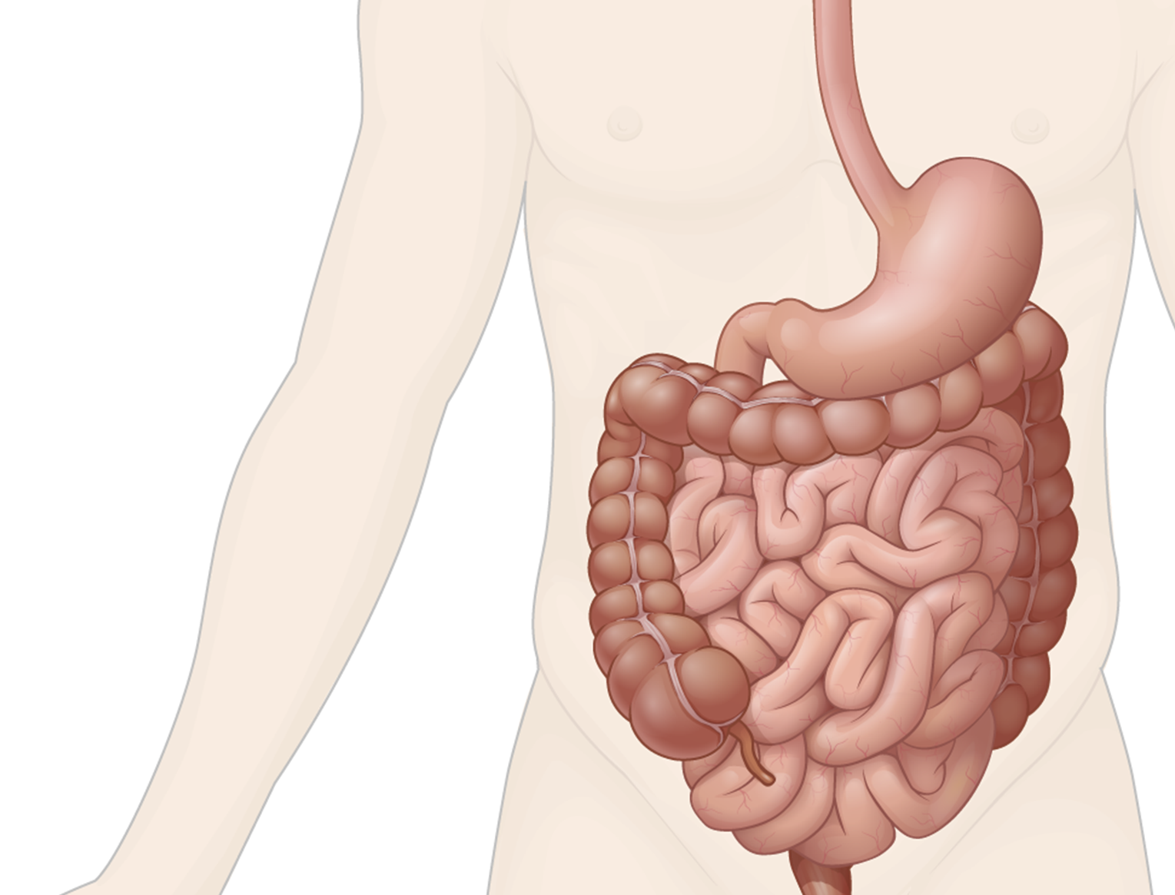
HOW ARE VITAMINS ABSORBED
Vitamin and mineral absorption relies largely on a shuttle to carry nutrients into the bloodstream (carrier-mediated).
There are a limited number of shuttles (ions, proteins, and other small molecules) and a limited number of absorption sites.
Vitamin and mineral absorption can be enhanced by presenting solutions in optimal concentration to the absorption sites.
Notes:
The absorption of vitamins and minerals relies upon shuttles to carry the nutrients from the intestinal tract into the bloodstream. The scientific term for this is carrier-mediated absorption. And all this means is that there are ions, proteins and other small molecules that act like taxis, carrying the nutrients into the blood. However, like in any real life situation, there never seem to be enough taxis when you need one.

Slide 22
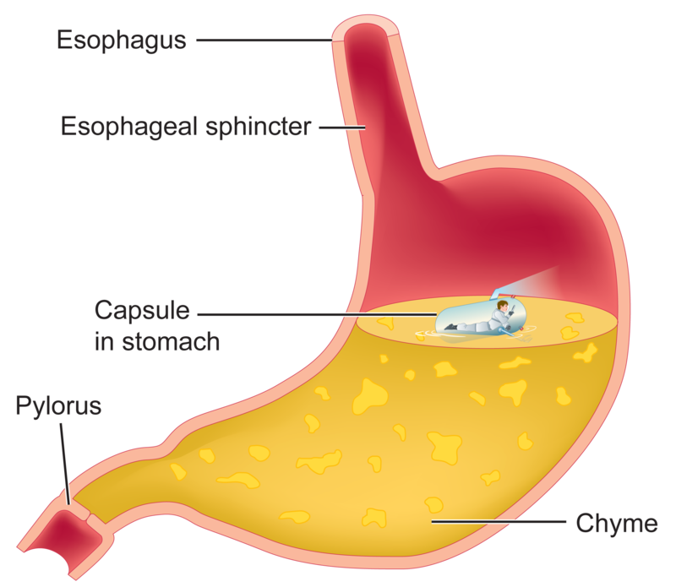
Pill may not completely dissolve before moving into intestinal tract.
Pills can get caught in the folds of the stomach.
Pill dissolves but the water taken with it makes the stomach dump contents and absorption sites become saturated.
Notes:
A pill does not fully deliver into your bloodstream the vitamins it holds within. Either the pill is dumped whole into the intestinal tract or the active ingredients pass through without fully absorbing.
Vitamins taken in Isotonix® form do not have this shortcoming. Isotonix® delivers nutrient-dense solutions which move from the stomach into the intestine in a fast, controlled way. And they’re buffered to resist nutrient degradation and to be gentle on your system.

Slide 23
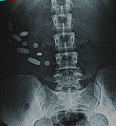
DO PILLS REALLY DISSOLVE?
Notes:
For those that may need further convincing, we see here an x-ray of pills taken that did not dissolve. They did not get absorbed into the bloodstream and get to release their actives.

Slide 24
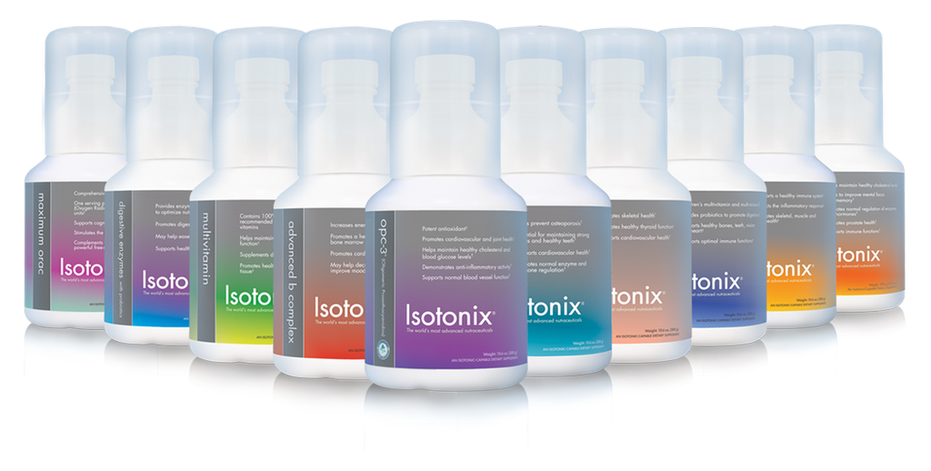
Offers a Powerful, Nutritional Solution!

Slide 25
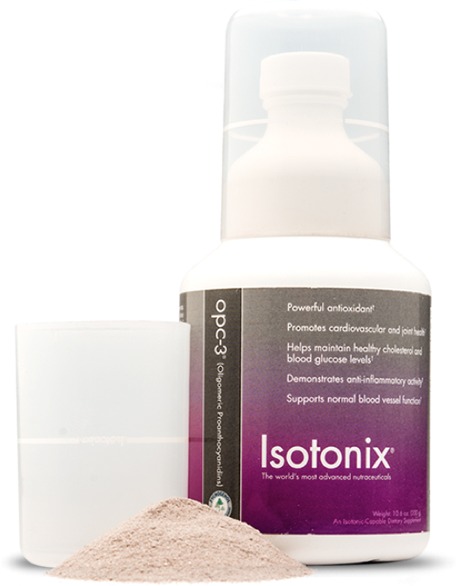
EXPERIENCE THE DIFFERENCE
Superior Quality
The Best Raw Materials
Trusted Manufacturers
GMP Standards
Good Manufacturing Practices
TGA approved
Best Science
Clinical Research
Proven Results
Isotonic Delivery
Notes:
Market Australia offers powerful nutritional solutions!

Slide 26
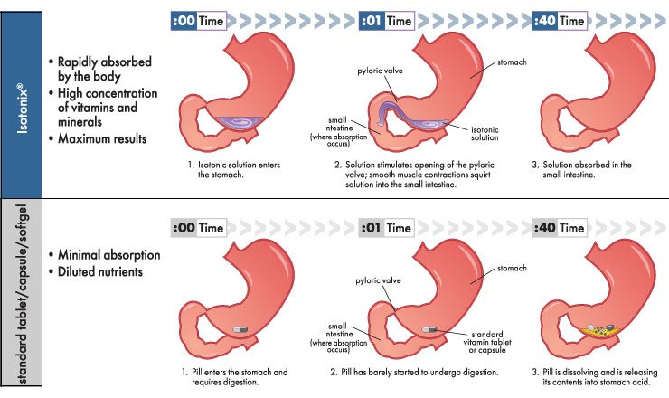
THE ISOTONIX ADVANTAGE
The careful formulation of Isotonix clears the stomach at an optimal, regulated rate to maximise absorption without saturation.
It’s fast but controlled, and allows your body’s own transport mechanisms to efficiently shuttle vitamins into the blood stream.
Notes:
This brings us to Isotonix Advantage #1. Isotonix products move out of the stomach at an optimal rate to maximize absorption.
It’s fast, but controlled; allowing your body’s transport mechanism to efficiently shuttle vitamins into the blood stream.
So let’s look at how Isotonix does this.

Slide 27
Each Ingredient has Multiple Functions
Ingredient | Primary Function | Secondary Function | Tertiary Function
Fructose | Control Gastric Emptying | Osmolality | Sweetener
Glucose | Control Gastric Emptying | Osmolality | Sweetener
Citric Acid | Buffer | Taste | Effervescence
Malic Acid | Buffer | Taste | Effervescence
Silicon Dioxide | Desiccant | Flow Agent
Maltodextrin | Moisture Control | Osmolality | Mouth Feel
Potassium Bicarbonate | Buffer | Effervescence
Calcium Sulphate | Desiccant | Flow Agent
Notes:
These are some of the base ingredients that make up Isotonix products. They are key to making our products isotonic. Each ingredient has multiple functions and there are certain concentrations that each ingredient needs to have to make it an isotonic product.
This is a key reason why our Isotonix products are superior because our advanced formulas that can not be duplicated.

Slide 28
Isotonix products are buffered to protect nutrients from Hydrochloric Acid degradation in the stomach.
The Isotonix® Advantage
Digestion
Hydrochloric Acid
Water
Enzymes
Pepsin
Intrincic Factor

Slide 29
The Isotonix® Advantage
Isotonix® products deliver the same concentration of particles as found in the body improving absorption of active ingredients.
Isotonix® solutions are gentle on your system because they simulate body fluid.

Slide 30
Food in the small intestine
Food in the small intestine
Blood stream
Carbon dioxide created by the effervescent reaction momentarily reduces the thickness and viscosity of the mucus layer of the intestinal tract, promoting absorption into the bloodstream.
Wall of small intestine

Slide 31
Isotonix offers an alternative to pills and tablets
Research has shown that 40% of adults have experienced difficulty swallowing pills.
Unlike pills and tablets, Isotonix® has no fillers or binders for the body to remove.

Slide 32
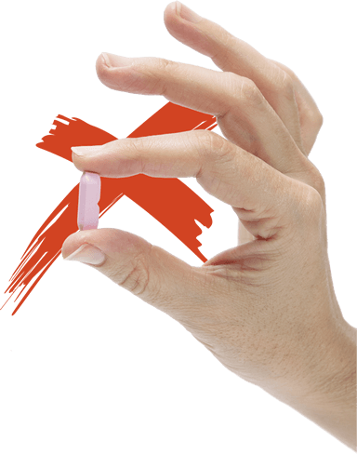
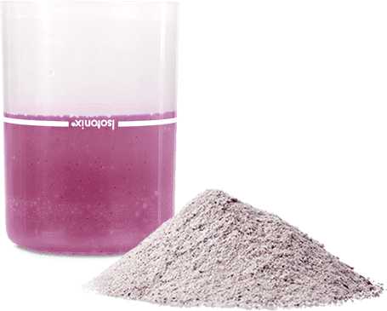
With Isotonix:
Rapidly absorbed by the body
High concentration of vitamins and minerals
Maximum results
With Standard Tablets:
Minimal absorption
Diluted nutrients

Slide 33
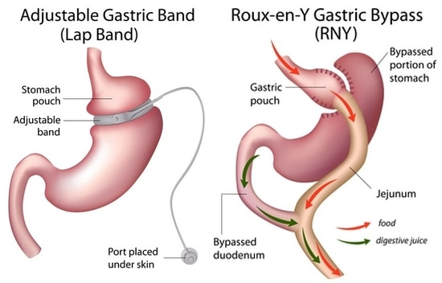
The Isotonix® Advantage
People with digestive (GI tract) challenges can benefit from isotonic delivery.
Acid reflux sufferers,
Bariatric patients (weight loss surgery)
Hiatal Hernia
Elderly (reduced acid production)

Slide 34
The World's Most Advanced Nutraceuticals.
Let us show you the
FUTURE.
marketaustralia |
Notes:
A recap of the Isotonix advantages;
Isotonix products clear the stomach at an optimal rate to maximise absorption.
It’s fast, but controlled; allowing your body’s transport mechanisms to efficiently shuttle vitamins into the blood stream.
Isotonix products are buffered to protect nutrients from hydrochloric acid degradation in the stomach.
The base ingredients in Isotonix deliver the same concentration of particles as found in your body fluids. This improves absorption of actives.
Isotonix solutions are gentle on your system because they simulate body fluid.
People with stomach challenges or trouble swallowing pills benefit from Isotonix delivery.

Slide 35
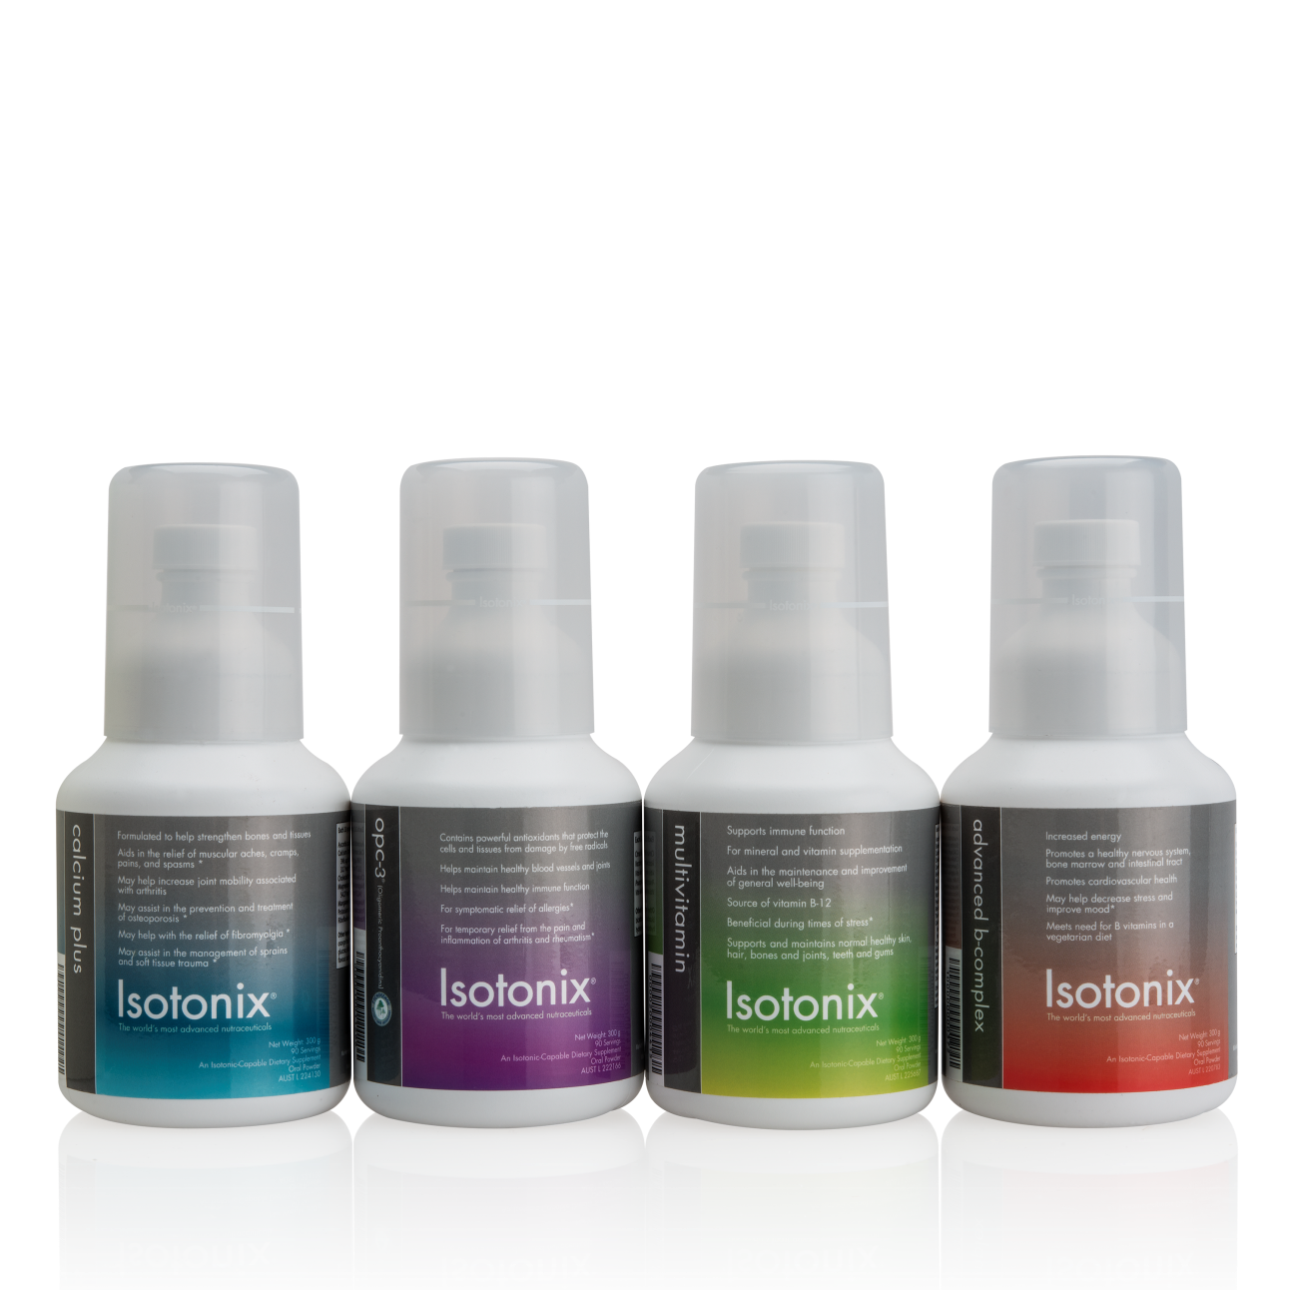
Get Started Building A Solid Foundation
ISOTONIX DAILY ESSENTIALS KIT
Isotonix OPC-3
Isotonix Calcium
Isotonix Multivitamin
Isotonix Advanced B Complex
Notes:
There’s nothing more important than taking care of yourself on a daily basis. With the Isotonix Daily Essentials Kit, you can be sure that you’re giving your body the essential vitamins, minerals and nutrients it needs thanks to four essential supplements – Isotonix OPC-3, Isotonix Multivitamin, Isotonix Advanced B-Complex and Isotonix Calcium Plus – to promote long-term health and optimal nutrition.
Plus, by purchasing the Isotonix Daily Essentials Kit instead of buying these products individually, you save 37%
A special offer should be shared by you going on auto-ship and include free shipping to ensure a great foundation and low price. Remember, manually, you can offer an additional 5 to 10 percent discount for autoships from your back office. This is something to remember for leverage because a customer on autoship is a guaranteed sale.
Primary Benefits of Isotonix® Daily Essentials Kit:
Receive essential vitamin and mineral supplementation
Helps maintain cardiovascular health
Increases energy, decreases stress and improves mood
Promotes normal cognitive performance
Helps maintain immunity & antioxidant protection

Slide 36
Isotonix OPC-3®
The Gold Standard For Antioxidants
Featured Ingredient - Pine Bark Extract (Pycnogenol®)
Basic Properties;
Antioxidant
Made from a combination of bilberry, grape seed and skin, pine bark extract and citrus bioflavonoid extract
Provide a variety of health benefits
Pycnogenol
Over 200 published studies
World’s only isotonic-capable form of Pycnogenol
Today, Pycnogenol is one of the most researched ingredients in the natural product marketplace.
Notes:
Caring for your general health starts with Isotonix OPC-3, a powerful antioxidant that provides a variety of health benefits associated with general health and well-being. From helping maintain immune functions, for symptomatic relief of allergies, or for temporary relief of the pain and inflammation of arthritis and rheumatism Isotonix OPC-3 helps the body function at its peak by combating free radicals throughout your body.

Slide 37
Whether you know it or not, your body is constantly being attacked by very harmful substances known as free radicals. You cannot see them, smell them, or touch them, but they are always there, trying to destroy body proteins and cell membranes. Free radicals are dangerous, and many scientists believe that continuous exposure to them is the major cause of aging and many of degenerative diseases.
OPCs eliminate free radicals! But you are probably asking what free radicals are?
Free radicals are small, highly reactive molecules which can be formed in cigarette smoke, processed, fried or microwaved foods, environmental chemical pollution, radiation and essentially normal metabolism.
Notes:
Caring for your general health starts with Isotonix OPC-3, a powerful antioxidant that provides a variety of health benefits associated with general health and well-being. From helping maintain immune functions, for symptomatic relief of allergies, or for temporary relief of the pain and inflammation of arthritis and rheumatism Isotonix OPC-3 helps the body function at its peak by combating free radicals throughout your body.

Slide 38
Isotonix OPC-3®
The Gold Standard For Antioxidants
Contains antioxidants that protect the cells and tissues from damages by free radicals.
Helps maintain healthy immune function and symptomatic relief of allergies
For temporary relief of the pain and inflammation of arthritis and rheumatism
Helps support cardiovascular health
Helps sustain joint flexibility
Helps sustain healthy circulation by strengthening capillaries, arteries and veins
Notes:
What sets Isotonix OPC-3 apart from other bioflavonoid products? Isotonix OPC-3 offers scientifically-supported oligomeric proanthocyanidins, or OPCs, found to be the most powerful antioxidants for human health. In addition to being powerful antioxidants, these individual OPCs have been shown to provide a myriad of specific health benefits. This science-driven selection of OPCs is unique to OPC-3, as is the Isotonix delivery system, which enables rapid and highly efficient absorption of the OPCs. The potent nutrients, in combination with the highly effective delivery system, makes OPC-3 the most powerful free radical scavenging product available.

Slide 39
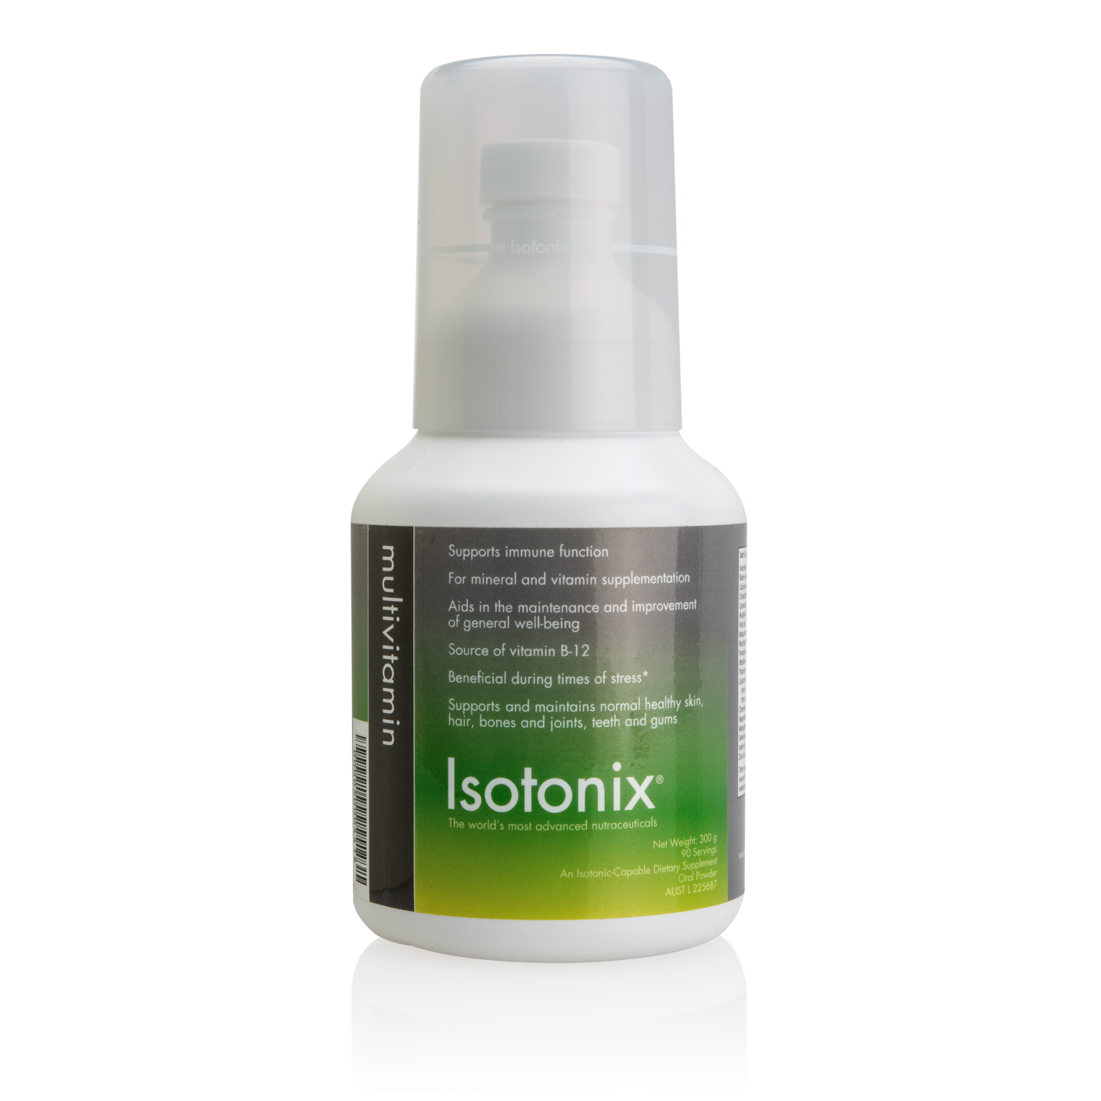
Isotonix Multivitamin®
Contains 100 percent or more of most of the recommended dietary intakes (RDI) of vitamins and minerals to help supplement deficiencies in diet
Supports sleep, nerve function, immune function, metabolism and conversion of food into energy, liver function, kidney function, thyroid function, adrenal function, hormonal balance, wound healing and tissue repair.
Supports and maintains normal healthy: skin, hair, bones and joints, teeth and gums
Aids in digestion/ Helps maintain healthy digestive function
Aids in the maintenance or improvement of general well being
Notes:
Next, Isotonix® Multivitamin contains 100 percent or more of most of the recommended dietary intakes (RDI) of vitamins and minerals to complement your diet. With today’s fast-paced lifestyles, it is important to ensure the body is getting the fuel it needs. Isotonix® Multivitamin supplements dietary deficiencies and helps maintain normal metabolic functioning.

Slide 40
Certain products are considered essential for everyone because they help assist the body in establishing a foundation for optimal health. One of these products is a multivitamin. When a diet is lacking, a multivitamin can help make sure you are still getting those essential vitamins and minerals from the foods you may not be eating.
A multivitamin makes sure the healthful nutrients in the food you eat don’t fall through the cracks.

Slide 41
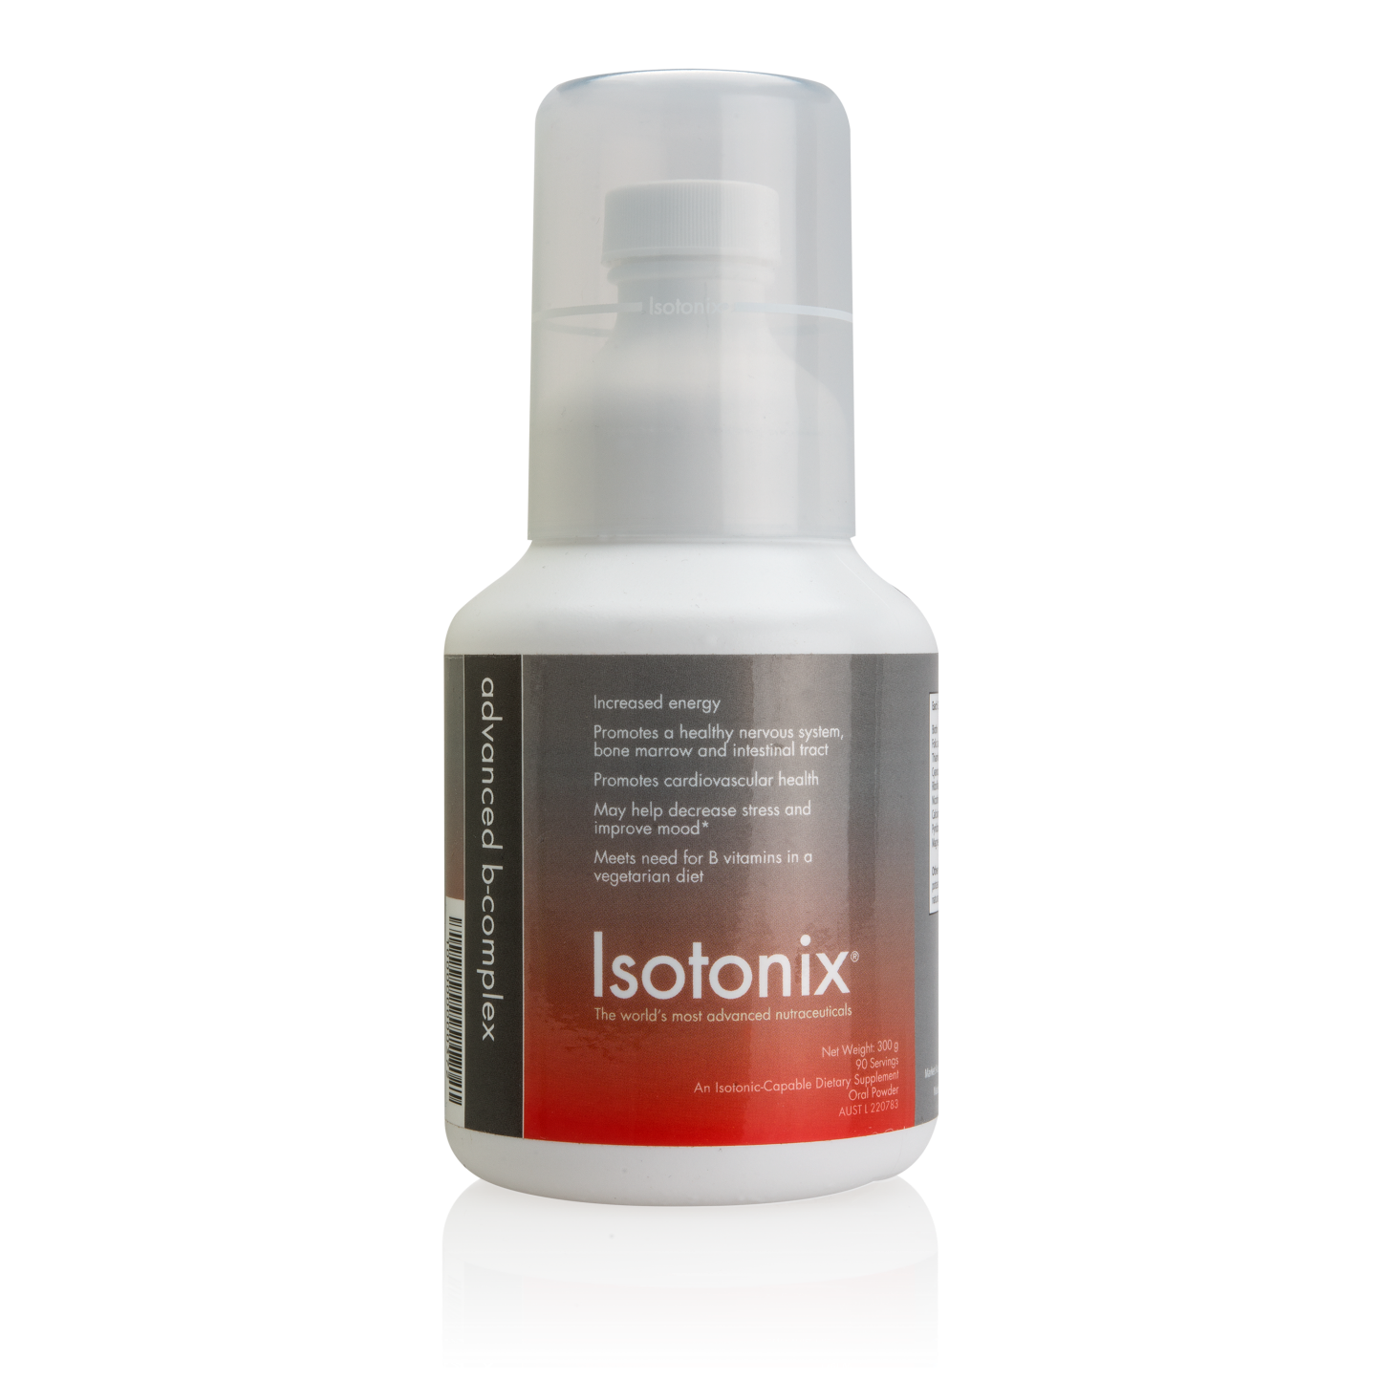
Isotonix Advanced B-Complex®
Increases energy
May help decrease stress and improve mood
Promotes normal cognitive performance
Promotes healthy aging
Promotes cardiovascular health
Promotes normal red blood cell formation
Helps maintain healthy levels of serotonin
Notes:
To provide the increased energy you need to function throughout the day, this kit includes Isotonix Advanced B-Complex, which delivers a combination of the eight essential B-vitamins that play a critical role in metabolism at the cellular level. B-vitamins are important for hundreds of biochemical reactions in the body. B vitamin deficiency can lead to fatigue and lethargy, which is why B-complex supplements are excellent energy boosters and anti-stress formulas. Because many vegetarian diets are lacking in the essential B-vitamins, Isotonix B-Complex meets the need for B-vitamins for vegetarians.

Slide 42
The body requires 13 vitamins, eight of which make up the B-group (or B-complex) vitamins. B vitamins are found in many foods, but because they are water soluble, they can’t be stored in the human body and therefore must come from the foods we eat or through supplementation.
B vitamins play an important role in keeping our bodies running like well-oiled machines. These essential nutrients help convert our food into fuel, allowing us to stay energised throughout the day.

Slide 43
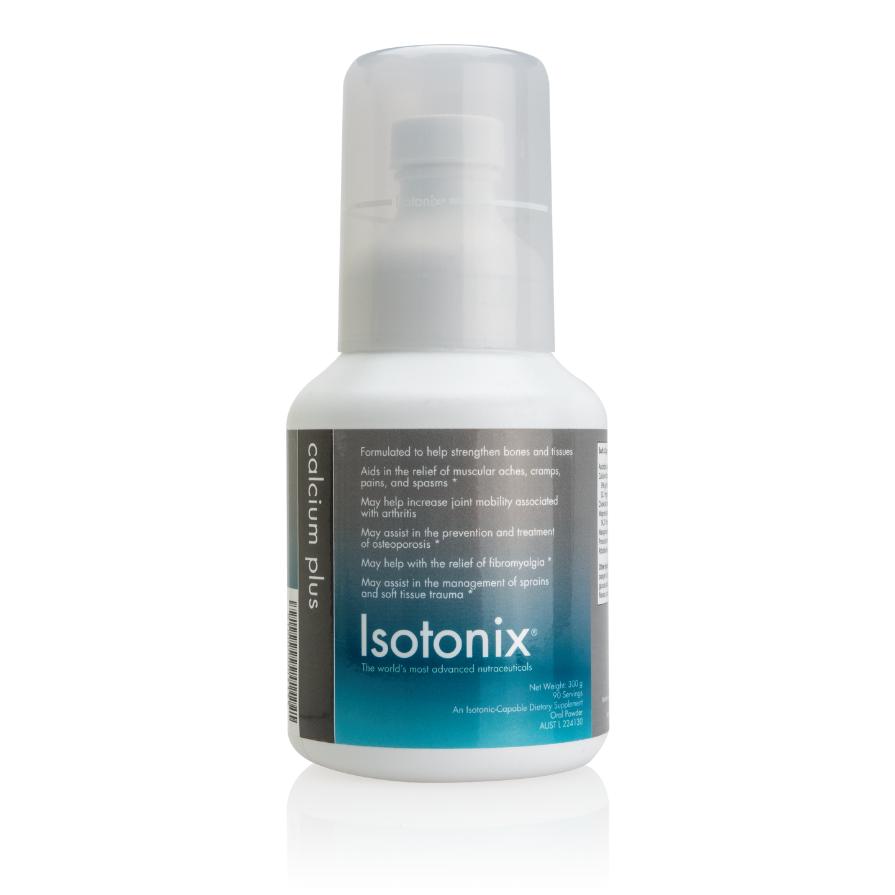
Isotonix Calcium®
A calcium supplement formulated to strengthen bone and tissue in growing and mature users
Supports skeletal health
Relief of muscular aches and pains
Relief and prevention of muscular cramps and spasms
Temporary relief of lower back pain*
Notes:
Finally, everyone needs calcium. Practically no one ingests enough calcium in their daily diet. Besides being helpful in supporting and maintaining bone integrity, calcium serves a dynamic role as a mineral. It's very important in supporting the activity of many bodily enzymes and maintaining proper fluid balance.
Isotonix Calcium Plus delivers a potent package of calcium and complementary nutrients to keep your bones strong. While calcium supplements in tablet form can be difficult for the body to absorb, the unique Isotonix delivery system and the inclusion of beneficial vitamins and minerals – including vitamin D – make Isotonix Calcium Plus more readily bioavailable and easily absorbed by the body.

Slide 44
Calcium is an essential mineral required for the growth and maintenance of our bones along with assisting the nerves and muscle functions. But few people ingest enough calcium in their daily diet. Besides being helpful in supporting and maintaining bone integrity, calcium serves a dynamic role as a mineral. It's very important in the activity of many bodily enzymes and maintaining proper fluid balance. Calcium also aids in the contraction of skeletal muscle.

Slide 45
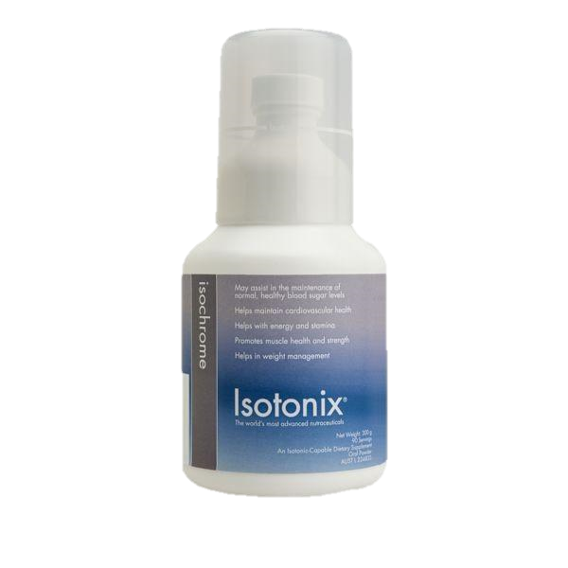
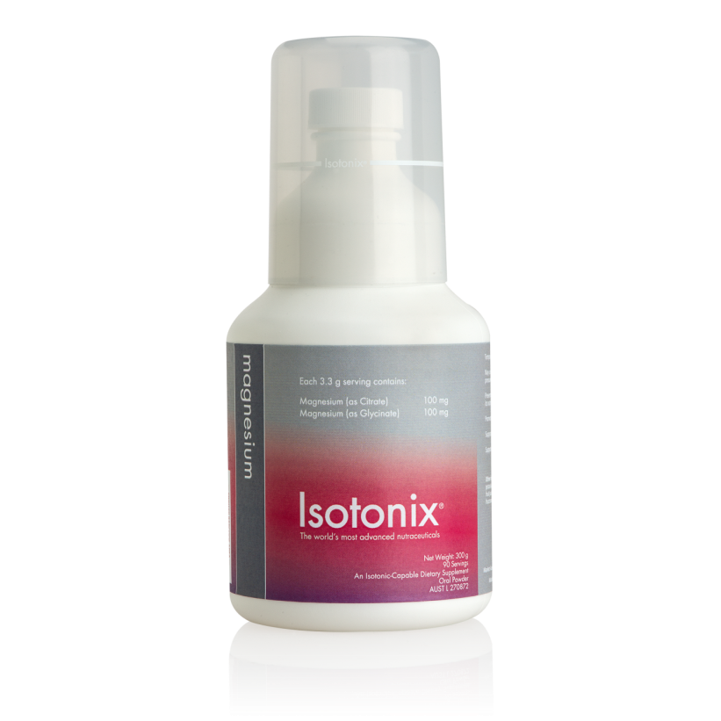
The Isotonix Family
OPC-3
ADVANCED B
MULTIVITAMIN
CALCIUM
ISOCHROME
VITAMIN C
MAGNESIUM
DIGESTIVE ENZYMES
Notes:
Why are Isotonix® supplements better than standard supplements?
Isotonix formulas are more effective than standard supplement formulas because they offer the best way to get the maximum delivery of vitamins and minerals into the bloodstream. Isotonix formulas are also the fastest and most effective way to receive vitamins, minerals and nutrients. The stomach has very little work to do because the pH and tonicity are carefully designed to allow the stomach to quickly release all the nutrients into the small intestine. With the Isotonix formulas, this process takes about five minutes, where a standard vitamin tablet can take up to four hours.

Slide 46
The Isotonix Family Benefits
Antioxidant protection
Vitamin and mineral intake
Immune system functions
Heart health
Bone and joint health
Management of stress and anxiety
Promotion of regular digestion
Blood sugar maintenance
Overall health and well-being
Notes:
Everything you need from Market Australia!

Slide 47
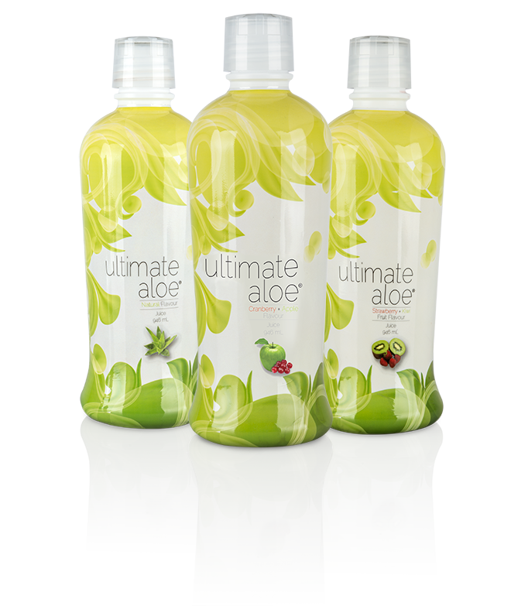
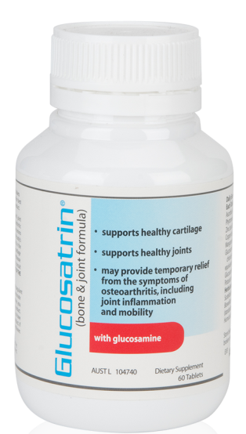
Additional MA Branded Products
Not all Market Australia supplements are available in Isotonix form. WHY?
Numerous factors are considered:
Taste or odor
Solubility (ability of ingredients to dissolve in water)
Availability of ingredient in powdered form
Optimal delivery method of ingredient
Notes:
Why aren’t all MA products made into Isotonix form?
Some ingredients have an odor or taste not easily masked
Some ingredients are not water soluble or dispersible
Some ingredients are oils or oily
Plant-based ingredients are made into pills so that they go through the normal digestive process; releasing the actives

Slide 48
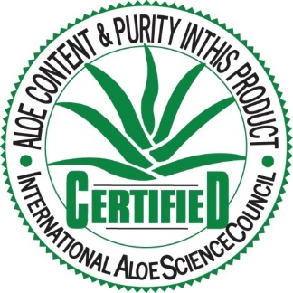
Ultimate Aloe
Contains the IASC (International Aloe Science Council) seal that certifies the aloe content and purity
A source of over 200 nutrients, enzymes, vitamins and minerals, including 13 of the 17 essential minerals needed for good nutrition
Contains no high fructose corn syrups or artificial sweeteners, thickeners or emulsifiers
Contains natural aloe vera leaf and ActiveAloe™ to enhance aloe vera’s biological activity
Source of amino acids
Harvested and processed to ensure the body receives maximum benefits
Comes in 3 great tasting and refreshing flavours!
Natural
Cranberry Apple
Strawberry Kiwi

Slide 49
Heart Health Essential Omega 111
Helps maintain cardiovascular health
Helps support normal blood pressure in healthy individuals
Omega 3 is important for the integrity of cell membranes
Omega 3 provides nutritional support for the maintenance of normal health, brain and cognitive function, especially in older adults
May provide temporary relief of arthritic pain
May help reduce joint inflammation
May help increase joint mobility associated with arthritis
May assist in the maintenance of triglycerides within the normal range in healthy individuals

Slide 50
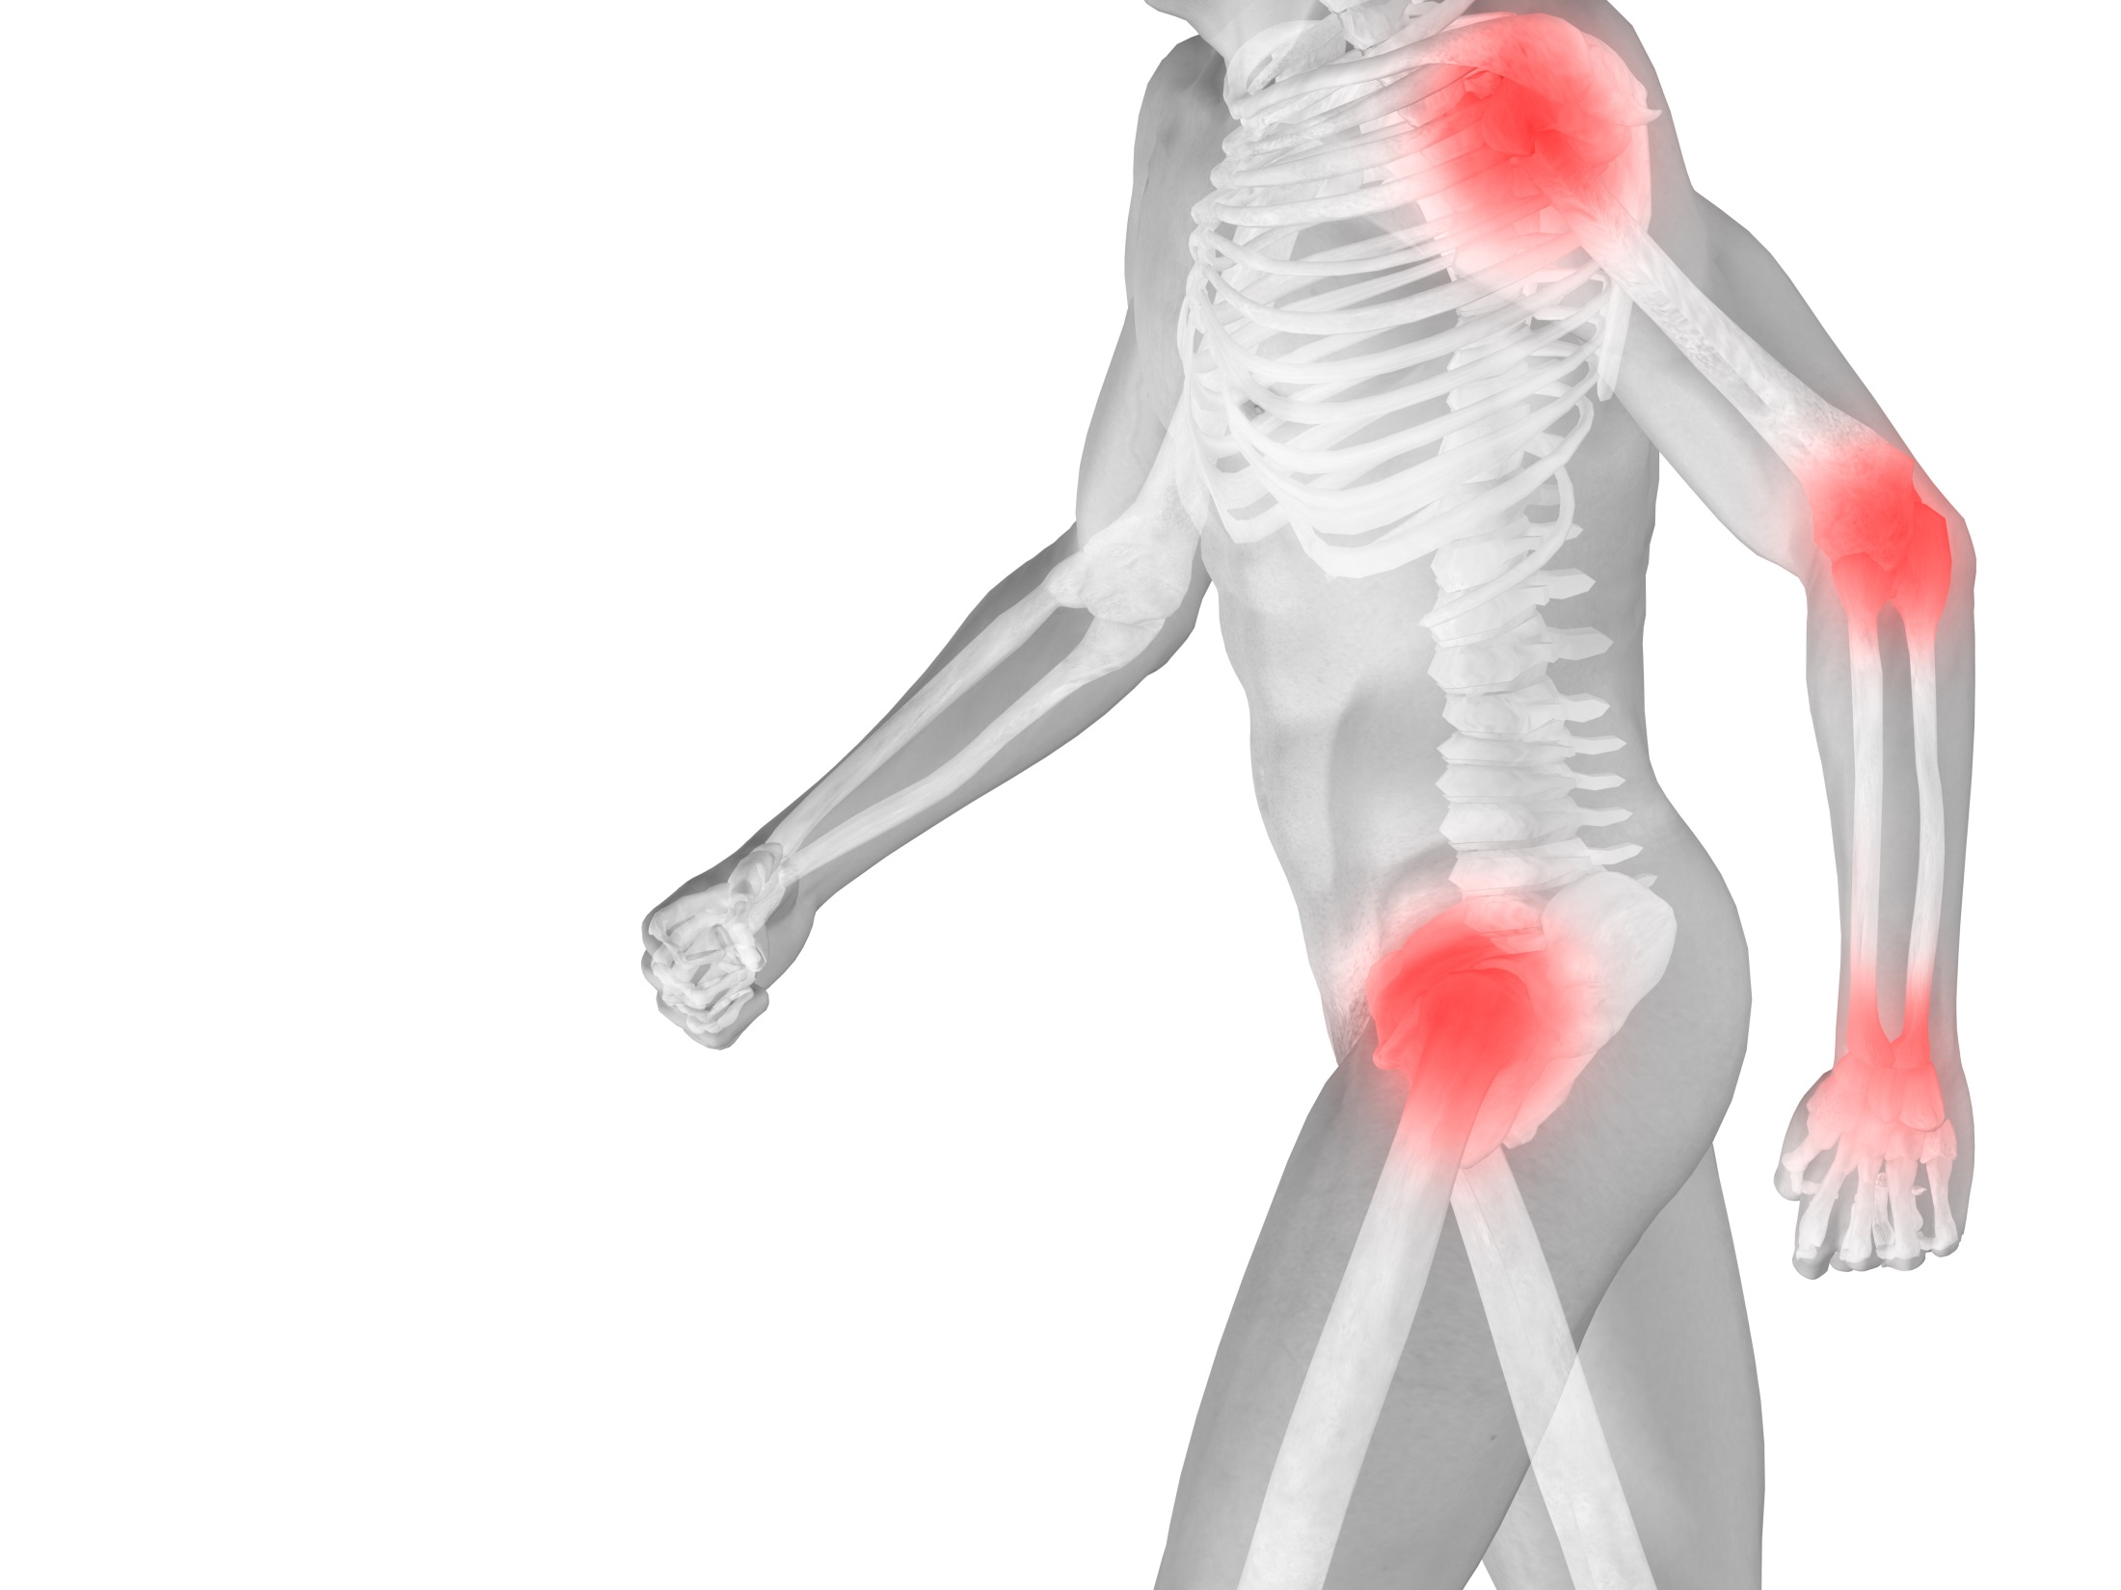
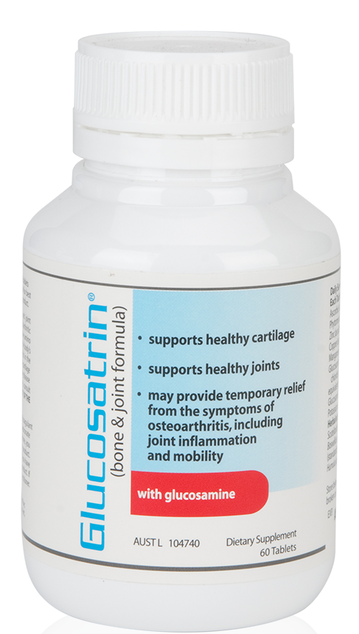
Glucosatrin
Aids in the management of osteoarthritis
Supports healthy cartilage
Supports healthy joints
Provides temporary relief from the pain of osteoarthritis
May reduce joint inflammation and increase joint mobility
Helps with the temporary relief of the pain, stiffness and joint swelling associated with arthritic conditions
Aids in the maintenance or improvement of general well-being

Slide 51
Your
JOURNEY
to
a
healthier
YOU starts
TODAY
Notes:
Be sure to visit us at AU.SHOP.COM today and follow us on social media!
Like us. facebook.com/marketaustralia
Find us. instagram.com/marketaustralia
Visit us. AU.SHOP.COM and GLOBAL.SHOP.COM
Watch us. youtube.com/marketaustraliaTV
Meet us. ma.meeton.com

Slide 52
SOCIALISE WITH US:
LEARN MORE
Notes:
Be sure to visit us at AU.SHOP.COM today and follow us on social media!
Like us. facebook.com/marketaustralia
Find us. instagram.com/marketaustralia
Visit us. AU.SHOP.COM and GLOBAL.SHOP.COM
Watch us. youtube.com/marketaustraliaTV
Meet us. ma.meeton.com

